Slide 1

Implementation of New HCPCS Codes for Intermittent Catheters
A Primer on the new HCPCS codes | February 2025

Slide 2


DRAFT
TABLE OF CONTENTS
New HCPCS
Codes for Intermittent Catheters
2. Background on Intermittent Catheters
3. Benefits of Hydrophilic Catheters
4. Reimbursement and Access
5. Questions & Discussion

Slide 3
CMS CREATED 3 NEW & MODIFIED 2 HCPCS CODES TO DISTINGUISH HYDROPHILIC COATING TECHNOLOGY
Current HCPCS Codes
New and Revised HCPCS Codes - Effective Jan 1, 2026¹
A4351 Straight tip, with or without coating (teflon, silicone, silicone elastomer, or hydrophilic, etc.)
A4351 – Straight tip, with or without coating (teflon, silicone, or hydrophilic, silicone elastomer, etc.), each
+
A4295 – Straight tip, hydrophilic coating, each
A4352 Coude tip, with or without coating (teflon, silicone, silicone elastomer, or hydrophilic, etc.)
A4352 – Coude tip, with or without coating (teflon, silicone, or hydrophilic, silicone elastomer, etc.), each
+
A4296 – Coude tip, hydrophilic coating, each
A4353
Catheter with insertion supplies
A4353 – Intermittent catheter with insertion supplies
+
A4297 – Intermittent catheter, hydrophilic coating, with insertion supplies, each
CMS’s final decision. Page 12: https://www.cms.gov/files/document/2024-hcpcs-application-summary-biannual-1-2024-non-drug-and-non-biological-items-and-services.pdf

Slide 4
TIMELY CODE ADOPTION IS CRUCIAL FOR UNINTERRUPTED ACCESS TO INTERMITTENT CATHETERS
Requests - Prior to 1/1/2026 :
Implement 3 new hydrophilic HCPCS codes (A4295, A4296, A4297)
Revise the definitions of A4351 and A4352 (remove hydrophilic)
Assign adequate reimbursement to ensure access to hydrophilic intermittent catheters
Notes:
1.

Slide 5
INTERMITTENT CATHETERS

Slide 6


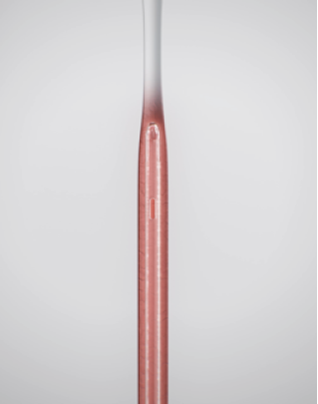
INTERMITTENT CATHETERS (ICs)
Single use¹ medical device that is inserted through the urethra to drain the bladder 4-6 times daily² (1,825 per year)
Used by patients with urinary retention and urinary incontinence, including those with neurogenic lower urinary tract dysfunction (NLUTD)
  Spinal cord injury, spina bifida, MS, Parkinson’s, late-stage diabetes, stroke, cancer, enlarged prostate (BPH), prolapse³
Approximately 1,300 ICs in three HCPCS codes⁴ (A4351, A4352 and A4353)
Complications and hospital readmissions are common^{2, 3}
Catheter choice is complex and multi-factorial⁶
Step 1
FDA. Reprocessing of single-use medical devices: Information for health care facilities.
Rognoni C., et al. BMC Urol. (2017)
American Association for Homecare. Urologicals white paper (2021)
Palmetto GBA. (n.d.). Product classification database
American Association for Homecare. Catheter diagram (December 2021).

Slide 7
ACCESS TO THE RIGHT INTERMITTENT CATHETER CAN BE CRITICAL FOR CLINICAL SUCCESS¹
Benign Prostate Hyperplasia
Hand Function
Mobility
Catheter tip (straight/coudé)
Firmness
Spinal Cord Injury
Gender
UTI History
Protective Sleeve
Gripping Aid
Multiple Sclerosis
Spina Bifida
Immune System
Instantly ready to use hydrophilic
catheter
Clinical Condition
Patient Factors
Catheter Features
Parkinson’s Disease
Setting Hospital/ Community
Hydrophilic coating requiring water for activation
Uncoated prelubricated with gel
Collection bag attached
Bladder Cancer
Access to Catheters
Diabetes
Independence with Self-care
Others...
Quality of Life
Compact size
(discreet)
COMPLIANCE OUTCOMES ADVERSE EVENTS QUALITY OF LIFE
Catheter Choice
American Association for Homecare. Catheter diagram (December 2021). https://aahomecare.org/files/galleries/Catheter_Diagram_12_21.pdf

Slide 8
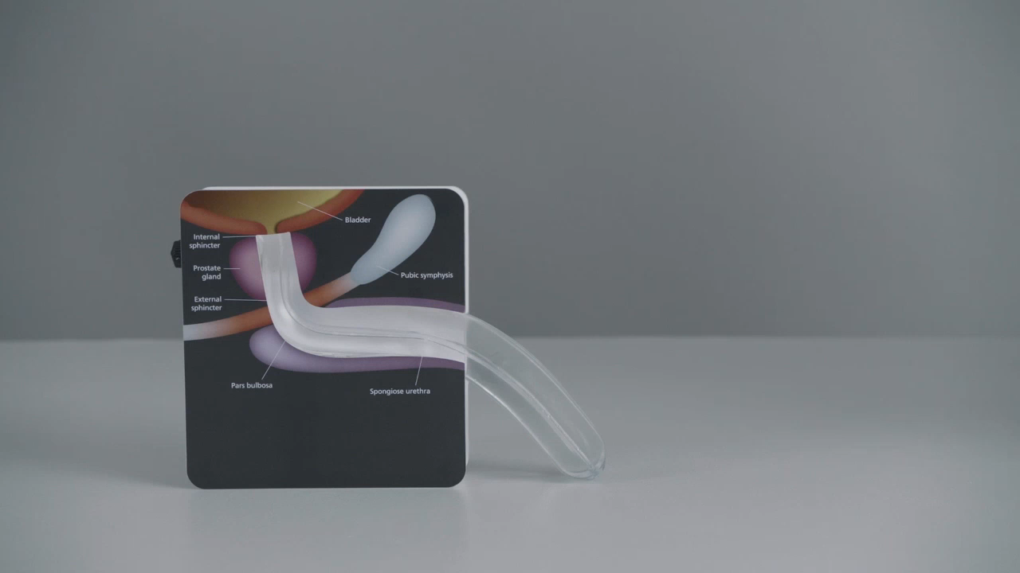
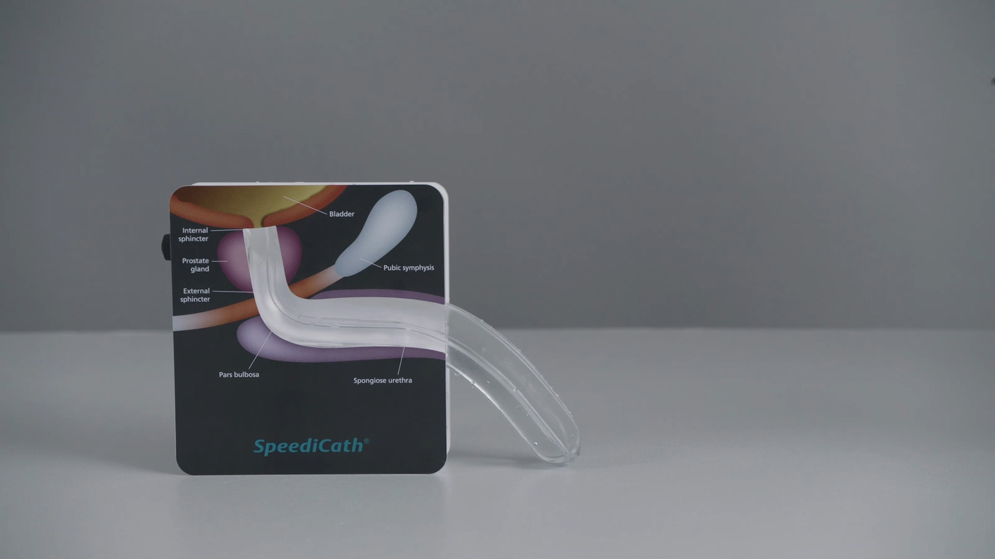
VIDEO COMPARISON OF HYDRO VS NON-HYDRO
Hydrophilic catheters minimize friction and enable smooth insertion and withdrawal
Non-Hydrophilic Coated Catheter
Hydrophilic Coated Catheter
Hydrophilic coating eliminates the need for separately reimbursed lubricant
Disclaimer: Blue dye test to demonstrate that the hydrophilic coating remains on the catheter throughout the catheterization process in contrast with non-hydrophilic coated catheter. The test used catheters from a single manufacturer from Dec. 2024

Slide 9
BENEFITS OF HYDROPHILIC CATHETERS
Hydrophilic catheters protect the fragile urethra by reducing friction,^{1, 2} resulting in up to:
  55%³ reduced risk of urethral trauma ²⁻⁷
  72% reduced risk of urethral strictures²
  Reduction of risk factors for UTIs,^{1, 3, 4, 8-9} pain and discomfort^{7, 10-12}
  Higher levels of patient satisfaction ⁵ vs. uncoated catheters¹⁰⁻¹⁴ which is associated with better adherence ¹⁵
Compared to uncoated catheters, hydrophilic catheter users:
  Have a 22% reduced risk of UTIs ¹⁴
  Avoid ~18 complications over their lifetime ¹⁵
Numerous professional associations, like the American Urological Association (AUA) and the Society of Urodynamics, Female Pelvic Medicine & Urogenital Reconstruction (SUFU), have published guidelines recognizing these clinical benefits of hydrophilic technology.¹⁶⁻²⁰
1. Ali, S., et al. BMC Urol (2024). 2. Liao, X., et al. Int Urol Nephrol (2022). 3. Feng, D., et al. Asian J Surg (2020). 4. Li, Arch Phys Med Rehabil (2013). 5. Cardenas, D. et al. PMR (2011). 6. Shamout, et al. Spinal Cord (2017). 7. Stensballe, J., et al. Eur Urol (2005). 8. Kennelly, M., et al. Advances in Urology (2019). 9. Clark, J., et al. Spinal Cord (2015). 10.. Barken, K., et al. BMC Urol (2022). 11. Newman, D., et al. Urologic Nursing (2021). 12. Ko, K., et al. Int Neurourol J (2022). 13. Barbosa et al. Patient preference and adherence (2012). 14. Plata, et al. World J Urol (2022). 15. Håkansson, et al. Urologic nursing (2016). 16. Ginsberg, et al. J Urol (2021). 17. Quallich, J Wound Ostomy Continence Nurs (2023). 18. IPAC, Best Practices for clean (2020). 19. Lauridsen, et al., EAUN guideline on IC in adults (2024). 20. Gould, et al., CDC (2009).

Slide 10

URINARY TRACT INFECTION IS A MULTIFACTORIAL CONDITION
Hydrophilic coated catheters can influence multiple risks factors associated with UTIs
Four domains of the UTI risk factor model¹
Intermittent catheterization
Bacteria inserted by product and no urethral rinsing
Urethral and bladder trauma from the product
Post void residual urine due to product design
General conditions
High intravesical pressure/impaired bladder compliance
Host deficiencies
Bowel dysfunction
Diabetes
Age and gender
User compliance/adherence
Voiding frequency
Fluid intake
Non-hygienic procedure
Insufficient education
Post void residual urine due to incorrect handling
Residence country and social support system
UTI
RISK FACTORS
Local urinary tract conditions
Bacterial virulence
Previous UTI
Botulinum toxin A injections
Urodynamic investigations
Bladder and kidney stones
Post void residual urine caused by bladder shape
1. Kennelly, M., et al. Advances in Urology (2019).

Slide 11
HYDROPHILIC CATHETERS REDUCE COMPLICATIONS, HEALTHCARE UTILIZATION, AND LONG-TERM HEALTHCARE COSTS
After experiencing a UTI, catheter users are 11 times more likely to experience a UTI the following year.
UTIs are associated with:
  17% higher hospital readmissions ($4247, 65% difference)
  6% higher outpatient services ($8204 higher payment)
  9% higher outpatient prescription refills ($1425, 31% difference)
  Median estimate of $15,131 representing 2.48 higher cumulated health care utilization payments over 2 years after injury ¹
Herrity, A., et al. Top spinal cord inj rehab (2023).

Slide 12
MEDICARE IC REIMBURSEMENT LANDSCAPE
HCPCS | Description | 2025 Medicare Allowable*
A4351 | Intermittent urinary catheter; straight tip, with or without coating (teflon, silicone, silicone elastomer, or hydrophilic), each | $2.53
A4352 | Intermittent urinary catheter; coude (curved) tip, with or without coating (teflon, silicone, silicone elastomeric, or hydrophilic, etc.), each | $8.97
A4353 | Intermittent urinary catheter, with insertion supplies | $9.79
12
1. CMS 2025 DMEPOS Medicare fee schedule: https://www.cms.gov/medicare/payment/fee-schedules/dmepos/dmepos-fee-schedule
*2025 Medicare ceiling rate

Slide 13
HYDROPHILIC CATHETERS CAN
PROVIDE BETTER OUTCOMES
Hydrophilic coated technology offers:
  Superior clinical evidence compared to non-hydro ICs
  Recognition from clinical and professional associations
  Reduced risk for complications associated with lower healthcare utilization
  Eliminates the cost for lubricant
  Improved user outcomes
  Improved compliance and quality of life
  Access to innovative products

Slide 14
TIMELY NEW & REVISED CODE ADOPTION IS CRUCIAL
FOR UNINTERRUPTED ACCESS TO INTERMITTENT CATHETERS
Value to the (insert plan name):
Ensure ongoing access to medically necessary hydrophilic ICs
Support access for members with multiple health plans or members that have Medicare as primary
Reduce financial and administrative burden for cross-over claims
Enhance data visibility and data collection
Provide hydro-IC utilization transparency
Maintain expected claim processing timeframes
Requests prior to 1/1/2026 :
Implement 3 new hydrophilic HCPCS codes (A4295, A4296, A4297)
Revise the definitions of A4351 and A4352 (remove hydrophilic)
Assign adequate reimbursement to ensure access to hydrophilic intermittent catheters

Slide 15
Bibliography
Reference number | Full reference citation
Slide 3
1 | Centers for Medicare and Medicaid Services (CMS). (2024, May). Centers for Medicare & Medicaid Services’ (CMS’) Healthcare Common Procedure Coding System (HCPCS) Level II Final Coding, Benefit Category and Payment Determination, B1 2024 HCPCS coding cycle. Retrieved from https://www.cms.gov/files/document/2024-hcpcs-application-summary-biannual-1-2024-non-durg-and-non-biological-items-and-services.pdf.
Slide 6
1 | U.S. Food and Drug Administration. Reprocessing of single-use medical devices: Information for health care facilities. https://www.fda.gov/medical-devices/products-and-medical-procedures/reprocessing-single-use-medical-devicmiotes-information-health-care-facilities.
2 | Rognoni C, Tarricone R. Intermittent catheterisation with hydrophilic and non-hydrophilic urinary catheters: systematic literature review and meta-analyses. BMC Urol. Jan 10 2017;17(1):4. doi:10.1186/s12894-016-0191-1.
3 | American Association for Homecare. (2022). The Critical Need to Provide Intermittent Catheter Urological Supplies Specific to Patient Need to Improve Health Outcomes (July 12, 2022). Retrieved from https://aahomecare.org/files/galleries/The_Critical_Need _to_Provide_Intermittent_Catheter_Urological_Supplies_Specific_to_Patinet_Need_to_Improve_Health_Outcomes_07_22.pdf.
4 | Palmetto GBA. (n.d.). Product classification database. https://www4.palmettogba.com/pdac_dmecs/initProductClassificationResults.do.
5 | American Association for Homecare. Catheter diagram (December 2021). https://aahomecare.org/files/galleries/Catheter_Diagram_12_21.pdf
Slide 7
1 | American Association for Homecare. (2021). Catheter diagram (December 2021). Retrieved from https://aahomecare.org/files/galleries/Catheter_Diagram_12_21.pdf.
Slide 9
1 | Ali, S., Khan, O.S., Youssef, A.M. et al. Hydrophilic catheters for intermittent catheterization and occurrence of urinary tract infections. A retrospective comparative study in patients with spinal cord injury. BMC Urol, 24, 122 (2024). doi: 10.1186/s12894-024-01510-y.
2 | Liao, X., Liu, Y., Liang, S. et al. Effects of hydrophilic coated catheters on urethral trauma, microtrauma and adverse events with intermittent catheterization in patients with bladder dysfunction: a systematic review and meta-analysis. Int Urol Nephrol 54, 1461–1470 (2022). doi: 10.1007/s11255-022-03172-x.
3 | Feng, D., Cheng, L., Bai, Y., Yang, Y., & Han, P. (2020). Outcomes comparison of hydrophilic and non-hydrophilic catheters for patients with intermittent catheterization: An updated meta-analysis. Asian J Surg, 43(5), 633–635. doi: 10.1016/j.asjsur.2019.12.009
4 | Li L, Ye W, Ruan H, Yang B, Zhang S, Li L. Impact of hydrophilic catheters on urinary tract infections in people with spinal cord injury: systematic review and meta-analysis of randomized controlled trials. Arch Phys Med Rehabil. Apr 2013;94(4):782-7. doi: 10.1016/j.apmr.2012.11.010.
5 | Cardenas, D.D., Moore, K.N., Dannels-McClure, A., Scelza, W.M., Graves, D.E., Brooks, M., et al. (2011). Intermittent catheterization with a hydrophilic-coated catheter delays urinary tract infections in acute spinal cord injury: a prospective, randomized, multicenter trial. PMR, 3(5), 408–417. doi: 10.1016/j.pmrj.2011.01.001.
6 | Shamout, S., Biardeau, X., Corcos, J., & Campeau, L. (2017). Outcome comparison of different approaches to self-intermittent catheterization in neurogenic patients: A systematic review. Spinal Cord, 55(7), 629–643. https://doi.org/10.1038/sc.2016.192.
7 | Stensballe J, Looms D, Nielsen PN, Tvede M. Hydrophilic-coated catheters for intermittent catheterisation reduce urethral micro trauma: a prospective, randomised, participant-blinded, crossover study of three different types of catheters. Eur Urol. 2005 Dec;48(6):978-83. doi: 10.1016/j.eururo.2005.07.009. Study supported by Coloplast.
8 | Kennelly, M., Thiruchelvam, N., Averbeck, M.A., Konstatinidis, C., Chartier-Kastler, E., Trøjgaard, P., et al. (2019). Adult neurogenic lower urinary tract dysfunction and intermittent catheterisation in a community setting: Risk factors model for urinary tract infections. Advances in Urology, Article 2757862. doi: 10.1155/2019/2757862. Study supported by Coloplast.

Slide 16
Bibliography
Reference number | Full reference citation
Slide 9 continued
9 | Clark, J.F., Mealing, S.J., Scott, D.A., Vogel, L.C., Krassioukov, A., Spinelli, M., et al. (2015). A cost-effectiveness analysis of long-term intermittent catheterisation with hydrophilic and uncoated catheters. Spinal Cord, 54(1), 73–77. doi: 10.1038/sc.2015.117.
10 | Barken, K.B., & Vaabengaard, R. (2022). A scoping review on the impact of hydrophilic versus non-hydrophilic intermittent catheters on UTI, QoL, satisfaction, preference, and other outcomes in neurogenic and non-neurogenic patients suffering from urinary retention. BMC Urol, 22, 153. doi: 10.1186/s12894-022-01102-8.
11 | Newman DK. Teaching Tool: Methods and Types of Urinary Catheters Used for Indwelling or Intermittent Catheterization. Urologic Nursing. 2021;41(2). doi:10.7257/1053-816x.2021.41.2.111.
12 | Ko KJ, Choo MS, Kim SO, Kim JH, Chung KJ, Yoo ES, Kim MK, Cho WJ, Choi JB, Lee J, Lee KS. A Multicenter, Open-Label, Observational Study Evaluating the Quality of Life After Using a Hydrophilic-Coated Catheter (SpeediCath) With Self-Intermittent Catheterization. Int Neurourol J. 2022 Dec;26(4):308-316. doi: 10.5213/inj.2244146.073.
13 | Barbosa CD, Balp MM, Kulich K, Germain N, Rofail D. A literature review to explore the link between treatment satisfaction and adherence, compliance, and persistence. Patient Prefer Adherence. 2012;6:39-48. doi: 10.2147/PPA.S24752. Epub 2012 Jan 13. PMID: 22272068; PMCID: PMC3262489.
14 | Plata M., Santander, J., Zuluaga, L. et al. Hydrophilic versus non-hydrophilic catheters for clean intermittent catheterization: a meta-analysis to determine their capacity in reducing urinary tract infections. World J Urol. 2022. 41(2), 491–499. Doi: 10.1007/s00345-022-04235-5.
15 | Håkansson, M.A., Neovius, K., & Lundqvist, T. (2016). Healthcare costs associated with hydrophilic-coated and non-coated urinary catheters for intermittent use in the United States. Urologic Nursing, 36(5), 233–242. doi: 10.7257/1053-816X.2015.35.5.239.
16 | Ginsberg, D., Boon, T., Cameron, A., Gousse, A., et al. (2021). The AUA/SUFU Guideline on Adult Neurogenic Lower Urinary Tract Dysfunction: Treatment and Follow-up. The Journal of Urology, 206(5), 1106–1113. doi: 10.1097/JU.0000000000002239.
17 | Quallich, S., Lajiness, M., Engberg, S., & Gray, M. (2023). Patient Education in Intermittent Catheterization: A Consensus Conference. Journal of wound, ostomy, and continence nursing : official publication of The Wound, Ostomy and Continence Nurses Society, 50(5), 393–399. doi: 10.1097/WON.0000000000001013.
18 | Infection Prevention and Control (IPAC) Canada. (2020). Best practices for clean intermittent urethral catheterization in adults: For nurses. https://ipac-canada.org/photos/custom/ Members/pdf/Clean-Intermittent-Urethral-Catheterization-Adults-for-Nurses-BPR-May2020.pdf.
19 | Lauridsen SV, V. R., Chagani, S., Daniels, A. et al (2024). Evidence-based guidelines for best practice in urological health care: Urethral intermittent catheterisation in adults, including urethral intermittent dilatation. European Association of Urology Nurses. Retrieved January 3, 2025 from https://nurses.uroweb.org/wp-content/uploads/EAUN-Guideline-indwelling-catheterisation-2024.pdf.
20 | Gould, C., Umscheid, C., Agarwal, R., Kuntz, G., et al on behalf of Center for Disease Control and Prevention. (2009). Guideline for prevention of catheter-associated urinary tract infections (CAUTI). https://www.cdc.gov/infectioncontrol/pdf/guidelines/cauti-guidelines-H.pdf.
Slide 10
1 | Kennelly, M., Thiruchelvam, N., Averbeck, M.A., Konstatinidis, C., Chartier-Kastler, E., Trøjgaard, P., et al. (2019). Adult neurogenic lower urinary tract dysfunction and intermittent catheterisation in a community setting: Risk factors model for urinary tract infections. Advances in Urology, Article 2757862. doi: 10.1155/2019/2757862. Study supported by Coloplast.
Slide 11
1 | Herrity, A.N., Castillo, C., Isakov, R.V., Anele, U.A., Wang, D., Boakye, M., et al. (2024). Health care utilization and cost associated with urinary tract infections in a privately insured spinal cord injury population. Topics in Spinal Cord Injury Rehabilitation, 29(1), 108–117. doi: 10.46292/sci22-00022.
Slide 12
1 | CMS 2025 DMEPOS Medicare fee schedule: https://www.cms.gov/medicare/payment/fee-schedules/dmepos/dmepos-fee-schedule

Slide 17




THANK YOU!
aahomecare.org
info@aahomecare.org
MEMBERSHIP CONSULTATION
LET'S CONNECT
Notes:
QR code goes to Mike’s Calendly page to book an appointment to chat with him

