Slide 1





SHAPING THE FUTURE OF HME:
PREPARING FOR THE RETURN OF COMPETITIVE BIDDING
“The return of the bidding program presents the most profound challenge for the DME community in years – and helping our members and this industry meet this challenge is the top priority for AAHomecare.”
- Tom Ryan, President & CEO

Slide 2

PRESENTED BY
  Tom Ryan, President & CEO, AAHomecare
  Jay Witter, Sr. Vice President Public Policy, AAHomecare
  Mina Uehara, Sr. Director Regulatory Affairs, AAHomecare
  Cara Bachenheimer, Head of the Government Affairs Practice at Brown & Fortunato and AAHomecare General Counsel

Slide 3
OVERVIEW OF TODAY’S WEBINAR
Background: Regulatory and Political Considerations
Timeline and Comment Submission
Review of Proposed Rule
Comment Submission Recommendations
AAH Strategy and Call for Action from Industry
Questions
Notes:
TOM

Slide 4
Background: Regulatory and Political Considerations
Operating in a Different Political Environment
  Not the usual playbook
Intel on the Proposed Rule:
  From the Administration
  Strong impetus for this to get done
Many changes happening the federal government
  Leadership Changes
  CMS Career Staff Changes

Slide 5
The Typical Implementation Timeline
Comments due August 29th
Final Rule slated to be released around November 1, 2025
Final Rule goes into effect on January 1, 2026
CMS could announce the next CBP Round in Q1 2026, or earlier

Slide 6
THE PROPOSED RULE—HIGHLIGHTS
1. PROPOSED CHANGES
  Addition of Medical Supplies
  Addition of CGM + Insulin Infusion Pumps
  Bid Ceiling
  SPA Calculation
  Number of Contracts
  RID CBP
  Reduction of Financial Documentation Requirements
2. ACCREDITATION CHANGES
REVOCATION AUTHORITY CHANGES
CHANGE IN MAJORITY OWNERSHIP (CIMO)
Notes:
We will focus on the major changes being proposed. There are many changes to Accrediting Organizations, and proposals that will not directly impact suppliers, those changes won’t be covered today.

Slide 7
ABOUT THE PROPOSED RULE —HIGHLIGHTS
  Proposed Addition of Medical Supplies to the CBP
  Due to the statute’s language, medical supplies have historically been excluded from CBP
  CMS makes a novel interpretation of the law to allow for medical supplies such as urological, ostomy, and tracheostomy supplies to be added to CBP

Slide 8
ABOUT THE PROPOSED RULE —HIGHLIGHTS
  Proposed Addition of CGM and Insulin Infusion Pumps to CBP
  Not an official announcement, but CMS details how CGMs and insulin infusion pumps could be added to CBP
  Change payment category of CGMs and insulin infusion pumps to Frequently and Substantial Servicing
      Amortize CGM purchase price over 60 months to set bid ceiling
      Bid on bundled rental rate for the CGM device and supplies
  Will likely combine CGM and insulin infusion pumps into one CBP product category, where CGM would be the lead item

Slide 9
ABOUT THE PROPOSED RULE– HIGHLIGHTS
Changes to the Bid Ceiling
Proposes changing the bid ceiling from the 2015 fee schedule (unadjusted) to:
  For CBP items included in a prior CBP:
    Lesser of 110% of previous SPA (for lead item) or 2015 fee schedule; and
    If it’s been more than 1 year since the SPA was paid in a prior CBP, ceiling is the most recent SPA plus the CPI updates plus 10%
  For items not previously included in a CBP:
    The current fee schedule

Slide 10
ABOUT THE PROPOSED RULE—HIGHLIGHTS
Calculating the SPA
  Currently it is the maximum winning bid.
  CMS Proposes to set the SPA at the 75th percentile of contractors’ bids
  CMS will determine the composite bid by:
      Determining how many contract suppliers are needed
      Listing all the bids from lowest to highest
      Choosing the required number of contractors/suppliers

Slide 11
ABOUT THE PROPOSED RULE– HIGHLIGHTS
Reduce the Number of Contracts Awarded
For product categories included in prior competitions, the number of contracts awarded will be no more than double the number of contract suppliers the previously furnished at least 5% of the items or services
For new product categories, the number of contract suppliers would not exceed 125% of the number of suppliers that furnished at least 3% of the total utilization of the lead item in the product category and CBA during the most recent calendar year prior to bidding
Proposes to change the minimum winners from 5 to
2 per competition

Slide 12
ABOUT THE PROPOSED RULE —HIGHLIGHTS
  Remote Item Delivery (RID) CBP
  Creation of a national or regional RID CBP with 7-10 contracts for each Product Category
  Proposes to establish RID CBPs for:
      Urological Supplies
      Ostomy Supplies
      Tracheostomy Supplies
      CGM
      Insulin Infusion Pumps
      Off-the-Shelf Orthotics
Notes:
This is similar to the national mail order program for diabetes testing supplies, but if a supplier has a location, beneficiaries can pick up from the contracted supplier locations, they can’t pick up from a non-contracted supplier.
This could potentially be for regional. The rule is not clear what a region would be—BEA, states?

Slide 13
ABOUT THE PROPOSED RULE —HIGHLIGHTS
  Reduction in Financial Documentation Requirements
  No longer require: tax returns, income statements, balance sheets, and cash flows as part of the required financial documentation submission
  Will continue to require bidders to submit a credit report (score or rating)

Slide 14
ABOUT THE PROPOSED RULE —HIGHLIGHTS
Reaccreditation Changes
Move from triennial to annual reaccreditation as a protocol to combat fraud and abuse
CMS cost estimates unrealistically low
All surveys must be unannounced
All locations must be surveyed
Notes:
Lots of concerns here. This would be a significant cost for both suppliers and AOs.

Slide 15
ABOUT THE PROPOSED RULE —HIGHLIGHTS
Revocation Authority
Proposes to expand when a PTAN can be revoked retroactively:
  Supplier’s number can be revoked if the beneficiary attests that they never received the item or service listed in the supplier’s claim
  False or misleading information on the 855S
  Failure to timely report ownership or other change
  Revocation of one location’s PTAN would cause all locations’ PTANs to be revoked
  Non-compliance with a Medicare Supplier Standard
Notes:
CMS lists the different scenarios where a retroactive revocation can occur

Slide 16
ABOUT THE PROPOSED RULE —HIGHLIGHTS
Change in Majority Ownership (CIMO)
Require suppliers with a majority ownership change in the first 36 months of enrollment to enroll as a new supplier
Mirrors the requirement for HHAs, also known as the “36-month rule”
Allows CMS to deactivate Medicare billing privileges for suppliers that are undergoing a CIMO and fail to meet re-enrollment requirements
Notes:
CMS lists the different scenarios where a retroactive revocation can occur

Slide 17
TIPS FOR SUBMITTING COMMENTS
CMS is accepting public comments through 11:59pm on August 29, 2025.
To submit, go to regulations.gov and make sure you are commenting to the: “Medicare and Medicaid Programs: Calendar Year 2026 Home Health Prospective Payment System Rate Update; Requirements for the HH Quality Reporting Program and the HH Value-Based Purchasing Expanded Model; Durable Medical Equipment, Prosthetics, Orthotics, and Supplies Competitive Bidding Program Updates; DMEPOS Accreditation Requirements; Provider Enrollment; and Other Medicare and Medicaid Policies” posting. (CMS-1828-P)
You can either type your comments into the comment box or attach a file.
Fill out the required fields as you see fit and make sure to click the ‘Submit Comment’ button at the bottom.

Slide 18
COMMENT WRITING RECOMMENDATIONS
Most effective comments come from first-hand experience
  How would the proposed changes impact your company, employees, beneficiaries and other patients?
Support the industry’s positions and provide context to how it would impact your company and the community you serve.
Personalize your comments to explain the negative impacts on your business and patient care.
Do not be emotional.
Do not include PHI—all comments are public.

Slide 19
COMMENT WRITING RECOMMENDATIONS
AAHOMECARE POSITIONS
  Oppose inclusion of CGMs and insulin infusion pumps to CBP
  Oppose moving CGMs and insulin infusion pumps to the frequent and substantial servicing payment category
  Oppose adding medical supplies to CBP
  Oppose the bid ceiling to be based on the SPA
  Oppose the reduction of number of contracts
  Oppose the removal of financial documentation requirements
  Oppose the annual reaccreditation survey
  Oppose retroactive revocation
  All are encouraged to reference AAHomecare’s Talking Points Document

Slide 20


Slide 21
CAPITOL HILL STRATEGY
AAHomecare is working with House and Senate Leadership, Committees and champions to address concerns with the DMEPOS proposed rule.
The Hill Strategy is a 4-pronged approach
  Challenging CMS’ statutory authority to bid Urologics and Ostomy. Also pointing out poor results in the original demonstration program
  Challenging the inclusion of Non-Invasive Ventilators in the bid program. CMS attempted to include NIV in competitive bidding for the 2021 round. House and Senate introduced legislation to stop this effort. CMS ultimately pulled NIVs from the bid program in 2020.

Slide 22
CAPITOL HILL STRATEGY-- CONTINUED
  Challenge the inclusion of Continuous Glucose Monitors from the bid program. We will work with supplier, manufacturers, and consumer groups on the issue. We will point out that the bidding OF CGMs will stifle innovation, which is contrary to the Administration's push to expand the usage of wearable devices.
  Work with Congress on the overall design changes of the bid program in the proposed rule. AAHomecare worked with CMS and Congress on safeguards to make competitive bidding a sustainable program – clearing price, strong financials, and bid ceiling at the unadjusted Medicare fee schedule. We will urge Congress to weigh in to the Administration on these issue and will seek legislation if necessary

Slide 23
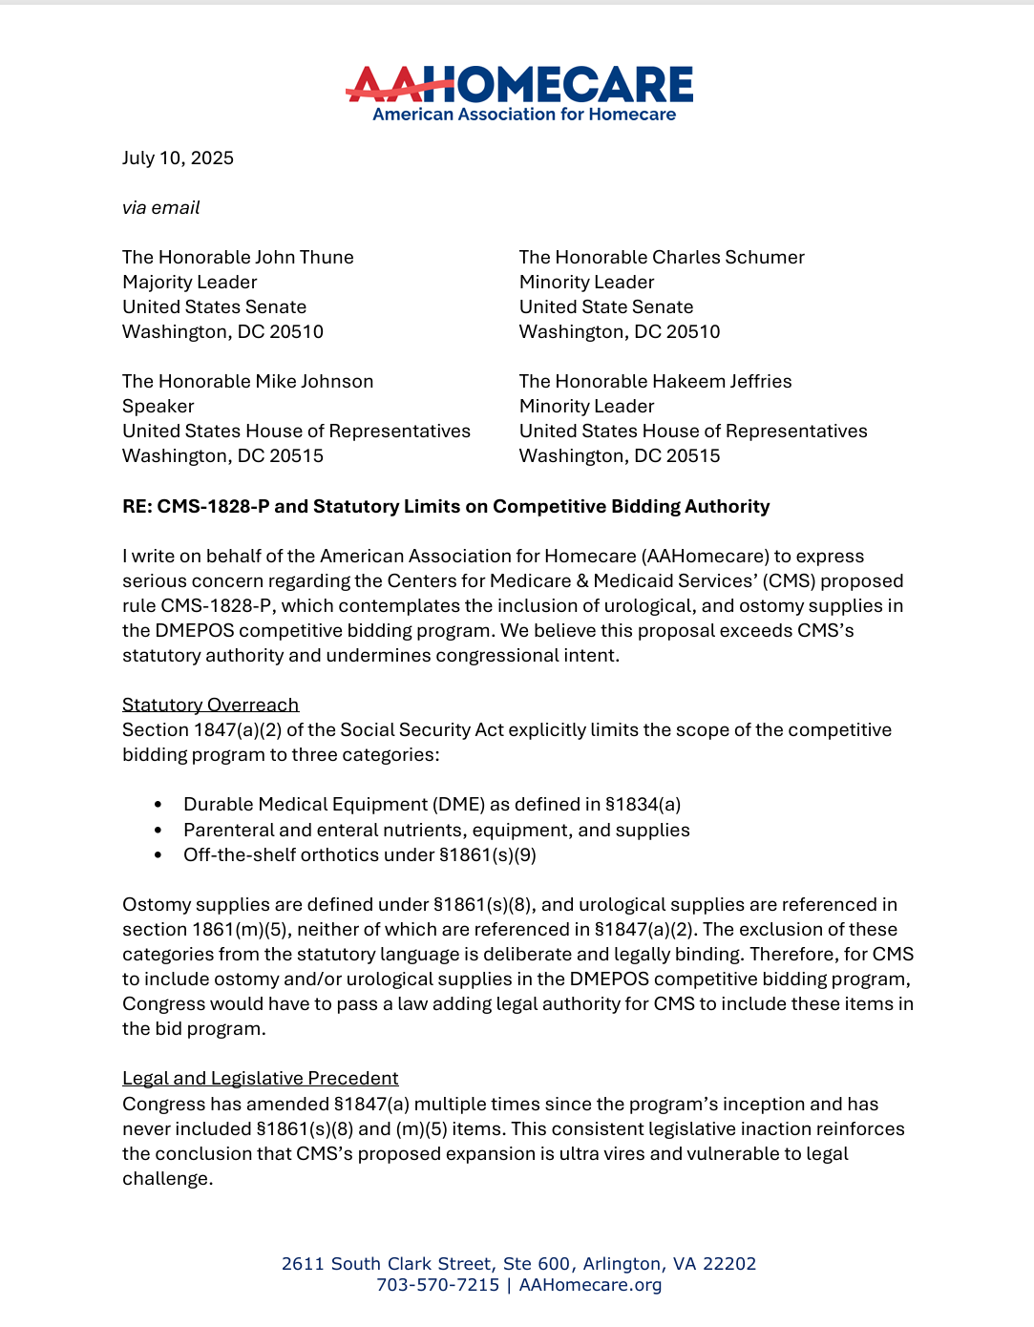
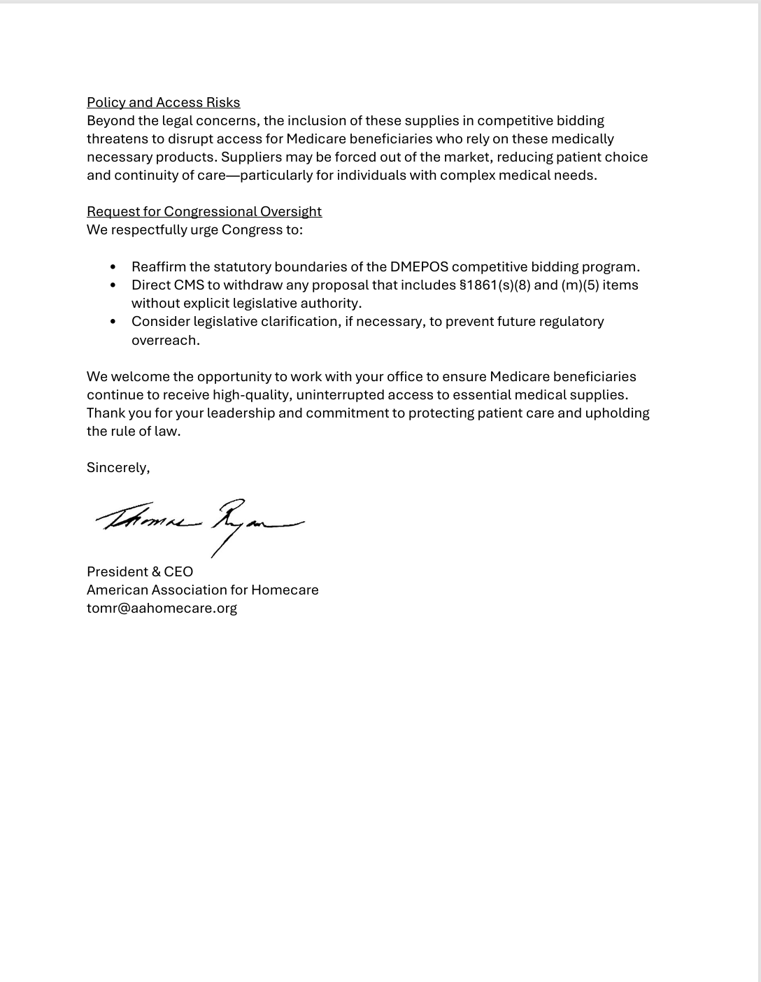
COMMUNICATION TO HOUSE/SENATE LEADERS

Slide 24
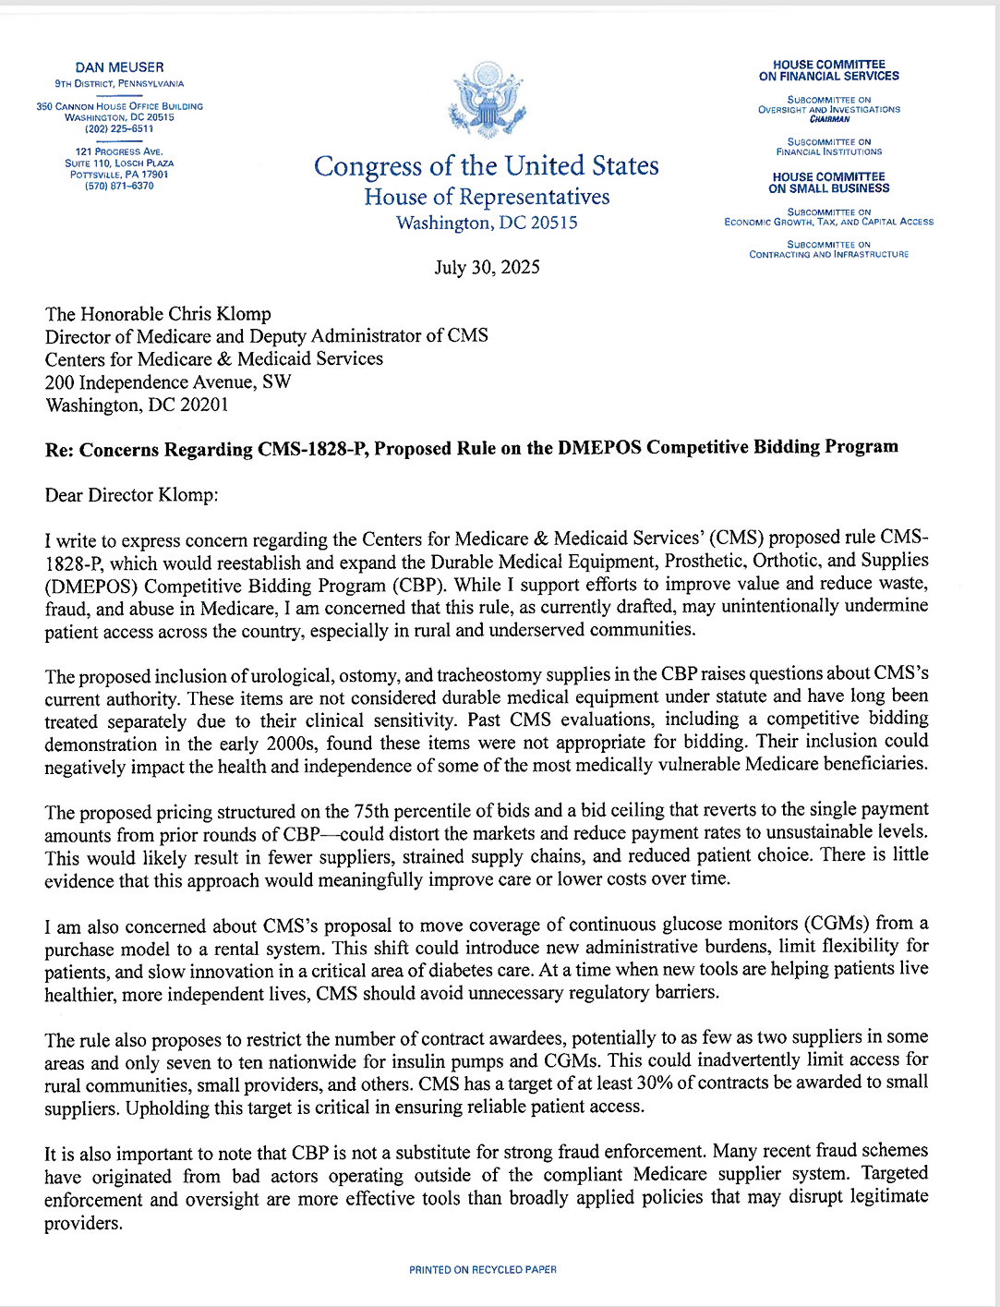
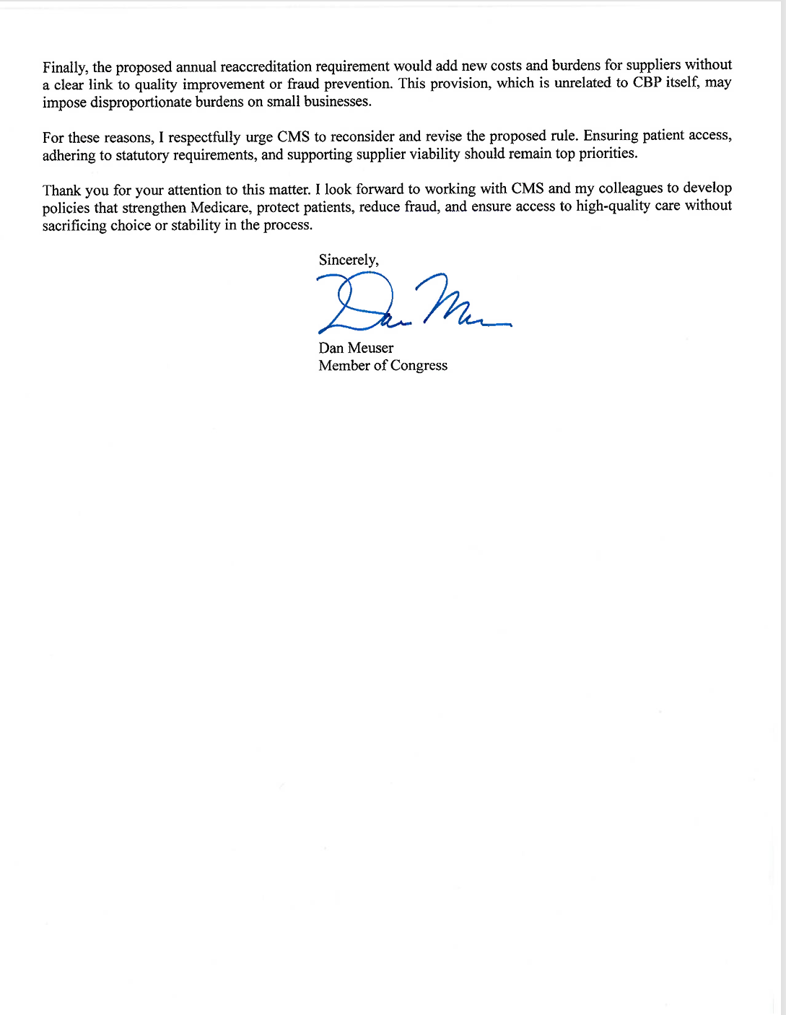
REP. DAN MEUSER LETTER TO CMS

Slide 25

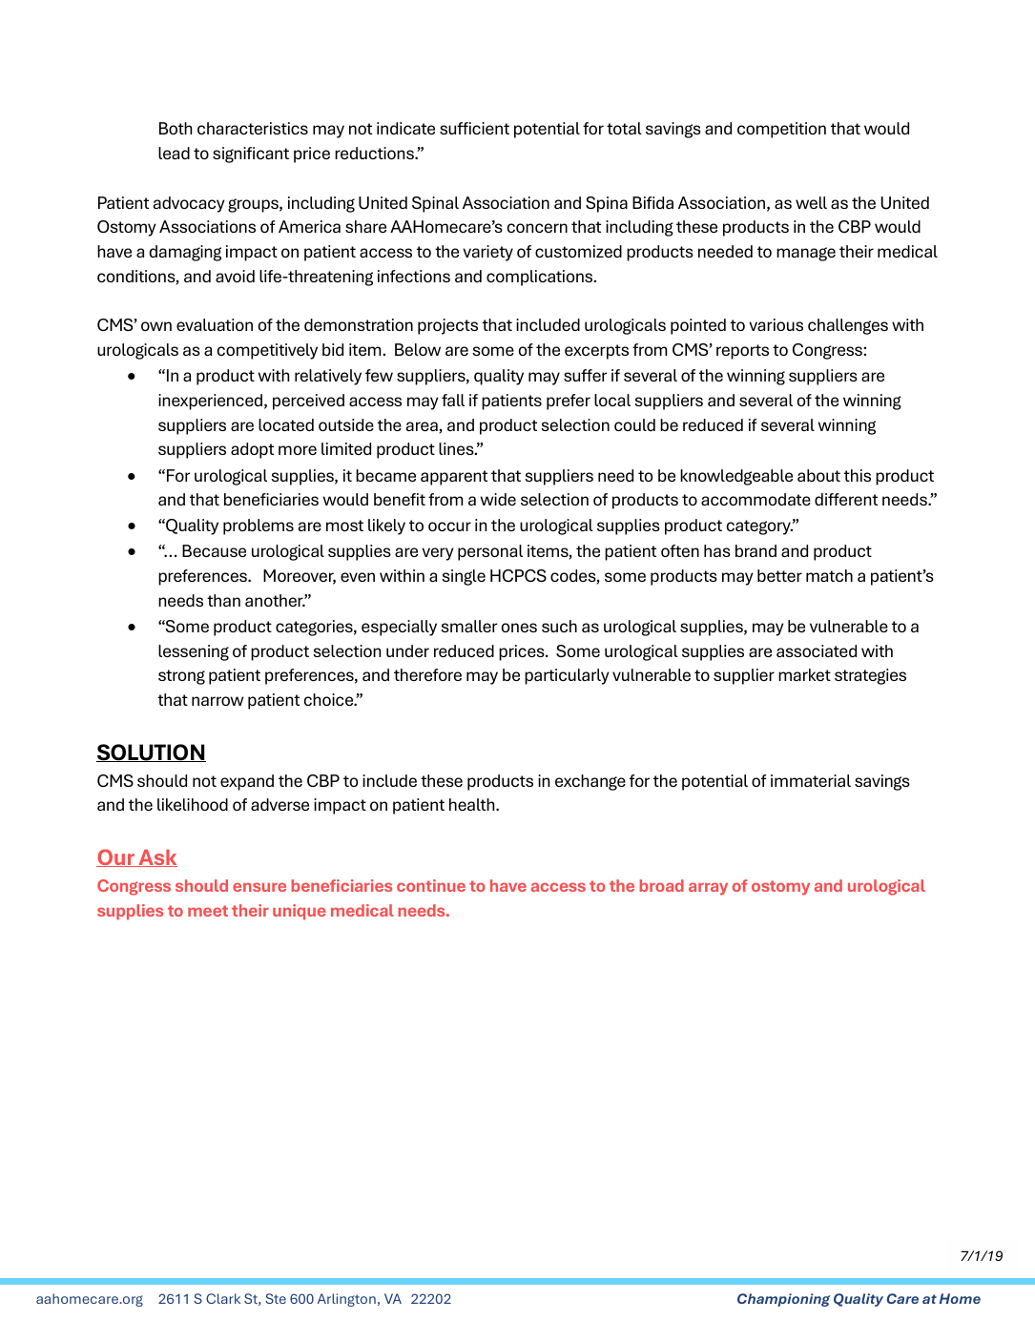
RESOURCES FOR THE HILL

Slide 26


RESOURCES
  aahomecare.org/2025-DMEPOS-proposed-rule
  AAHomecare will update our members with breaking news and share our comments in the Insider newsletter.
  The recording of this session and slides will be shared with all who registered for the webinar.
If you are not currently a member but would like to receive information and assistance navigating competitive bidding, please reach out to Michael Nicol at michaeln@aahomecare.org.

